Slide 1
Integrating the Standards for Mathematical Practices into Your Classroom
Valerie Arias Neil Haner
Brookside Elementary Brookside Elementary

Slide 2
Drive FOLDER
COPY OF PRESENTATION
AND RESOURCES
https://goo.gl/jnxUEX
I

Slide 3
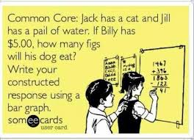

Slide 4
Workshop Objectives
How can I use the 4 C’s Framework to increase the use of the Standards for Mathematical Practice in math tasks and assignments?

Slide 5
Think-Pair-Share
Think: What do I already know about the SMP?
Pair: What does the SMP look like in your classroom?
Share: Share one idea with the room

Slide 6
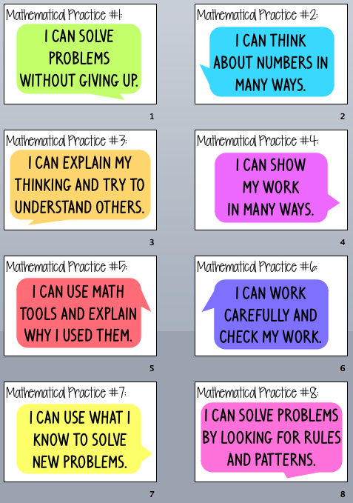

Slide 7
The 4 C’s
Clue What is the problem asking me to find or do? | Calculate What math did I use to solve this? Show your work! (Standard Algorithm)
Create How can I use a model or visual representation to show my thinking? | Communicate What can I write to explain my thinking and defend my answer?

Slide 8
The 4 C’s

Slide 10
Using the SMP
Clue What is the problem asking me to find or do? SMP # 1, 7 | Calculate What math did I use to solve this? Show your work! SMP # 1, 4, 5, 6, 7, 8
Create How can I use a model or visual representation to show my thinking? SMP # 1, 2, 4, 5, 6, 7, 8 | Communicate What can I write to explain my thinking and defend my answer? SMP # 1, 2, 3, 4

Slide 11
Using The 4 C’s with a Math Journal Task
Students are given a Math journal task from the Units of Study or an Application problem from Engage New York.
2. Students are given 12-18 Minutes to work on their own to complete the 4 boxes

Slide 12
3. Students are picked randomly to present their task and solution on the elmo.
4. All other students listen to presentation, and then ask questions to the presenter,
challenging their thinking, offering suggestions or advice and how to revise their work.

Slide 13
Student Work Examples

Slide 14
Video Examples

Slide 15
Implementation Tips
Be Patient!
Model ⇛ Group ⇛ Partner ⇛ Independent
Must have/ Can have vocabulary list
Students can present to groups, partners or FlipGrid
Have students write questions before hand/ make class list
Encourage and celebrate when a student makes a mistake
Name strategies after students
Differentiate questions and lessen boxes if needed
Add a box on the back for reflection.. Next time I will…

Slide 16
Implementation Tips
Use Avid question Stems (in resource folder)
Use One problem for homework (Higher DOK than worksheet)
Students must present, even if not complete
Time to revise and re-do

Slide 17
Integrating with Tenmarks

Slide 18
Your Turn
The top surface of a desk has a length of 5.6 feet. The length is 4 times the width. What is the width of the desk?
Length
Width
Multiply
Tenths
Times
Model

Slide 19
What are some sources of Math Tasks?
How could you adapt this framework for use in your classroom?
The next topic I am teaching is?
Some tasks that I can use are…?

Slide 20
Thank You!

